Slide 1
Data Modelling, Management and Governance CIS108-6
Lecture 4:
Database Operations via SQL
Gangmin Li

Slide 2
Review
We have know RDMS:
A Relational database management system (RDBMS) is a database management system (DBMS) that is based on the relational model (introduced by E. F. Codd).
The data in an RDBMS is stored in tables. It is a collection of related data records and it consists of numerous columns and rows.
The columns in a table called fields, the name of fields is called attributes. The value rang of the attributes is called domain.
A row of data in a table is called record.

Slide 3
Review
A relation table stores related data. The relation is a lists of constraints that used to limit the type of data that can go into a table. This ensures the accuracy and reliability of the data in the database.
Data modelling ensures the data integrity in RDBMS:
Entity Integrity: There are no duplicate rows in a table.
Domain Integrity: Enforces valid entries for a given column by restricting the type, the format, or the range of values.
Referential Integrity: Rows cannot be deleted, which are used by other records.
User-Defined Integrity: Enforces some specific business rules that do not fall into entity, domain or referential integrity.

Slide 4
Review
Database Normalization is the process of efficiently organizing data in a database. There are two reasons of this normalization process:
Eliminating redundant data. For example, storing the same data in more than one table.
Ensuring data dependencies make sense.
Normalization guidelines are divided into normal forms; a normal form is the format or the way a database structure should laid out. The aim of normal forms is to organize the database structure, so that it complies with the rules of first normal form (1NF), then second normal form (2NF) and finally the third normal form (3NF) .

Slide 5
Outline
What is SQL? SQL Syntax
Database operations
Table Operations
Records Operations
Pattern Matching (Condition construction)
Specify Return Records (Return restriction)
Join (operate on multiple tables)
Union (Combine multiple results)
Other Advanced Operations (index, view, transaction)
Import and export with CSV file

Slide 6
What is SQL

Slide 7
What is SQL?
SQL stands for Structured Query Language, which is a computer language for storing, manipulating and retrieving data stored in a relational database.
SQL is the standard language for Relational Database System. All the Relational Database Management Systems (RDMS) like MySQL, MS Access, Oracle, Sybase, Informix, Postgres and SQL Server use SQL as their standard database language.
Some RDMS uses different dialects, such as:
MS SQL Server using T-SQL,
Oracle using PL/SQL,
MS Access version of SQL is called JET SQL (native format) etc
Notes:
7

Slide 8
Why SQL?
SQL offers the following advantages:
Allows users to access data in the relational database management systems.
Allows users to describe the data.
Allows users to define the data in a database and manipulate that data.
Allows to embed within other languages using SQL modules, libraries & pre-compilers.
Allows users to create and drop databases and tables.
Allows users to create view, stored procedure, functions in a database.
Allows users to set permissions on tables, procedures and views.

Slide 9
A Brief History of SQL
1970 – Dr. Edgar F. "Ted" Codd of IBM is known as the father of relational databases. He described a relational model for databases.
1974 – Structured Query Language appeared.
1978 – IBM worked to develop Codd's ideas and released a product named System/R.
1986 – IBM developed the first prototype of relational database and standardized by ANSI. The first relational database was released by Relational Software which later came to be known as Oracle.

Slide 10
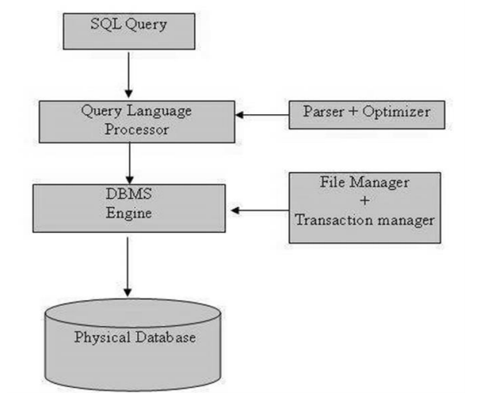
SQL Process
SQL is in a form of command (from command line interface) or statement (in a language). It is processed by a SQL engine (interpreter), which has the following architecture:
From tutorialspoint https://www.tutorialspoint.com/sql/sql_tutorial.pdf

Slide 11
SQL Commands
The standard SQL commands can be classified into three groups based on their nature:
DDL - Data Definition Language:
Commands that defines a databases – Create, Alter and Drop
DML – Data Manipulation Language:
Commands that maintain and query a databases – Create, Alter and Drop
DCL – Data Control Language
Commands that control a database including administering privileges and committing data

Slide 12
SQL Syntax

Slide 13
SQL Syntax
SQL, like any other computer languages, is followed by a unique set of rules and guidelines to ensure users’ command is correctly interpreted and executed by the DBMS. These rules are syntax.
All the SQL statements start with any of the keywords like SELECT, INSERT, UPDATE, DELETE, ALTER, DROP, CREATE, USE, SHOW and all the statements end with a semicolon (;).
SQL is case insensitive, which means SELECT and select have same meaning in SQL statements.
(MySQL makes difference in table names. So, if you are working with MySQL, make sure the database name is case correct).

Slide 14
SQL Syntax
Some typical SQL statement (command) are:
SELECT <column_names> FROM <table_name> WHERE {conditional expression} ORDER BY <column_name> [ASC|DESC] GROUP BY <column_name>;
CREATE TABLE <table_name( column1 datatype, column2 datatype, column3 datatype, ..... columnN datatype, PRIMARY KEY( one or more columns ) )>;
UPDATE <table_name> SET <column1 = value1,[ column2 = value2,..., columnN=valueN]> [ WHERE CONDITION];
DELETE FROM <table_name> WHERE {CONDITION};
DROP DATABASE <database_name>;

Slide 15
Conventions
< …> user specified
{} must exist list
[] optional list
Upper case: reserved works, operators
Lower case: variable, values, expressions

Slide 16
SQL Data Types
Like any other languages, SQL has specifics for data can be stored and manipulated in tables.
The most commonly used data types are:
DATA TYPE | FROM | TO
Int | -2,147,483,648 (32 bits) | 2,147,483,647
Numeric | -10^38 +1 | 10^38 -1
Float | -1.79E + 308 | 1.79E + 308
Real | -3.40E + 38 | 3.40E + 38
Char | 1 Char | Maximum Fixed length of 8,000 characters.
Varchar | Varchar | Maximum of 8,000 Variable-length characters.
Text | text | Variable-length with a maximum length of 2,147,483,647 characters
Datetime | Jan 1, 1753 | Dec 31, 9999
timestamp | unique number | A database-wide unique number that gets updated every time a row gets updated

Slide 17
SQL Expressions and Operators
An expression is a combination of one or more values, operators and SQL functions that evaluate to a value.
SQL uses expressions to query databases for specific set of data.
Boolean Expressions: using relational and logical operators and results in TRUE or FALSE.
Numeric Expression: using Arithmetic operators linked with variable and values, result in a numerical value.
Date Expression: Date Expressions return current system date and time values
Like any other languages, SQL uses operators to form expressions for comparison and arithmetic operations.
Operators are used to specify conditions in an SQL statement (WHERE) and to serve as conjunctions for multiple conditions in a statement.
Relational (Comparison) operators
Logical operators
Arithmetic operators
Operators used to negate conditions

Slide 18
SQL Relational Operators
Assume variable a holds 10 and variable b holds 20, then:
Operator | Description | Example
= | Checks if the values of two operands are equal or not, if yes then condition becomes true. | (a = b) is not true.
!= OR <> | Checks if the values of two operands are equal or not, if values are not equal then condition becomes true. | (a != b) is true.
> | Checks if the value of left operand is greater than the value of right operand, if yes then condition becomes true. | (a > b) is not true.
< | Checks if the value of left operand is less than the value of right operand, if yes then condition becomes true. | (a < b) is true.
>= OR !< | Checks if the value of left operand is greater than or equal to the value of right operand, if yes then condition becomes true. | (a >= b) is false
<= OR !> | Checks if the value of left operand is less than or equal to the value of right operand, if yes then condition becomes true. | (a <= b) is true.

Slide 19
SQL Logical Operators
Logical operators are same with any other languages and has the same semantics.
Operator | Description | Example
AND | Linked with two relational operations. Result in true ONLY both relations are true | A (true) AND B (true) = true
OR | Linked with two relational operations. Result in true if any relation is true | A OR B = T (any one of the A and B is true)
NOT | Checks if the values of two operands are equal or not, if values are not equal then condition becomes true. | NOT A (invert A’s value)

Slide 20
SQL Domain (Range) Operators
Operator | Description
ALL | compare a value to all values in another value set.
ANY | compare a value to any applicable value in a list.
BETWEEN | search for values that are within a set of values, given the minimum value and the maximum value.
IN | compare a value to see if it is appeared in a list.
EXISTS | search for the presence of a row in a specified table
LIKE | compare a value to similar values using wildcard operators.
IS NULL | compare a value with a NULL value.
UNIQUE | searches every row of a specified table for uniqueness (no duplicates).

Slide 21
SQL Arithmetic Operators
Assume 'variable a' holds 10 and 'variable b' holds 20
Operator | Description | Example
+ (Addition) | Adds values on either side of the operator. | a + b will give 30
- (Subtraction) | Subtracts right hand operand from left hand operand. | a - b will give -10
* (Multiplication) | Multiplies values on either side of the operator. | a * b will give 200
/ (Division) | Divides left hand operand by right hand operand. | b / a will give 2
% (Modulus) | Divides left hand operand by right hand operand and returns remainder. | b % a will give 0

Slide 22
Database Operations
Data Definition Language

Slide 23
CREATE Database
The SQL CREATE DATABASE statement is used to create a new SQL database.
Syntax:
the database name should be unique within the RDBMS.
Example: to create a new database <testDB>, we use,
CREATE DATABASE <DatabaseName>;
SQL> CREATE DATABASE testDB;
You can check it in the list of databases as follows
SQL> SHOW DATABASES;

Slide 24
DROP or DELETE Database
The SQL DROP DATABASE statement is used to drop an existing database in SQL schema.
Syntax:
DROP DATABASE <DatabaseName>;
Example:
If you want to delete an existing database <testDB>, then the DROP DATABASE statement would be
SQL> DROP DATABASE testDB;
You can check it in the list of databases as follows:
SQL> SHOW DATABASES;

Slide 25
SELECT Database
Before starting your operation, you need to select a database where all the operations would be performed.
Syntax:
USE <DatabaseName>;
Example:
if you want to work with the AMROOD database, then you can execute the following SQL command
SQL> USE AMROOD;
Notice that the database name is case-sensitive. If you are not sure the spelling of the name, it is better to check,
SQL> SHOW DATABASES;

Slide 26
Table Operations

Slide 27
CREATE Table
Creating a basic table involves naming the table and defining its columns and each column's data type.
Syntax:
CREATE TABLE table_name (
column1 datatype,
column2 datatype,
column3 datatype,
.....
columnN datatype,
PRIMARY KEY( one or more columns )
);
Table name has to be unique. Column name and type need to be defined.
A copy of an existing table can be created using a combination of the CREATE TABLE statement and the SELECT statement.

Slide 28
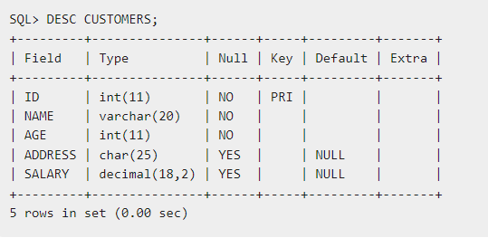
Example: creates a CUSTOMERS table with an ID as a primary key and NOT NULL are the constraints
SQL> CREATE TABLE CUSTOMERS(
ID INT NOT NULL,
NAME VARCHAR (20) NOT NULL,
AGE INT NOT NULL,
ADDRESS CHAR (25) ,
SALARY DECIMAL (18, 2),
PRIMARY KEY (ID)
);
DESC command can be sued to check if your creation of table ahs been successful.

Slide 29
DROP or DELETE Table
DROP TABLE statement is used to remove a table definition and all the data
Syntax
DROP TABLE <table_name>;
Example
Let us first verify the CUSTOMERS table and then we will delete it from the database.
SQL> DROP TABLE CUSTOMERS; Query OK, 0 rows affected (0.01 sec)

Slide 30
Records Operations
CRUD: create, retrieve, update, and delete

Slide 31
INSERT
Add new rows of data to a table in the database.
Syntax
INSERT INTO <table_name> (column1, column2, column3,...columnN)
VALUES (value1, value2, value3,...valueN);
You may not need to specify the column(s) name in the SQL query if you are adding values for all the columns of the table. But make sure the order of the values is in the same order as the columns in the table.
Example
The following statements would create six records in the CUSTOMERS table.
INSERT INTO CUSTOMERS (ID,NAME,AGE,ADDRESS,SALARY) VALUES (1, 'Ramesh', 32, 'Ahmedabad', 2000.00 );
INSERT INTO CUSTOMERS (ID,NAME,AGE,ADDRESS,SALARY) VALUES (2, 'Khilan', 25, 'Delhi', 1500.00 );

Slide 32
INSERT INTO CUSTOMERS (ID,NAME,AGE,ADDRESS,SALARY) VALUES (3, 'kaushik', 23, 'Kota', 2000.00 );
INSERT INTO CUSTOMERS (ID,NAME,AGE,ADDRESS,SALARY) VALUES (4, 'Chaitali', 25, 'Mumbai', 6500.00 );
INSERT INTO CUSTOMERS (ID,NAME,AGE,ADDRESS,SALARY) VALUES (5, 'Hardik', 27, 'Bhopal', 8500.00 );
INSERT INTO CUSTOMERS (ID,NAME,AGE,ADDRESS,SALARY) VALUES (6, 'Komal', 22, 'MP', 4500.00 );
We can use the second INSERT syntax to create a record in the CUSTOMERS table.
INSERT INTO CUSTOMERS VALUES (7, 'Muffy', 24, 'Indore', 10000.00 );
We can populate the data into a table through the select statement over another table;
INSERT INTO first_table_name [(column1, column2, ... columnN)] SELECT column1, column2, ...columnN FROM second_table_name [WHERE condition];

Slide 33
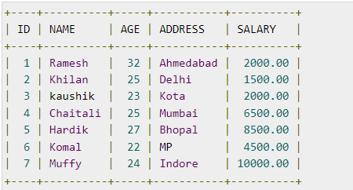
SELECT
To fetch the data from a database table which returns this data in the form of a result table.
Syntax:
SELECT [column1, column2, column] FROM <table_name>;
Fetch selected fields
SELECT * FROM <table_name>;
Fetch all the fields
Examples:
1. Fetch all fields in CUSTOMERS.
SELECT * FROM table_name;

Slide 34
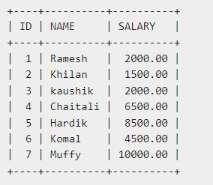
2. Fetch selected fields like ID, Name and Salary
SELECT ID, NAME, SALARY FROM CUSTOMERS;
Fetch selected fields with specified conditions

Slide 35
SELECT with WHERE
SQL uses WHERE to specify conditions an operation needs to stratify. It can be used in SELECT, UPDATE and DELETE.
WHERE clause is a Relational expression, which linked multiple logic express with relational operators.
Syntax: WHERE <Conditional Expression>
If no relational expression is given then it is TRUE by default.
Conditional expression ::= <Relation expression> Logical Operators <Relation expression>
Logical expression ::= <Arithmetical expression> Relational Operators < Arithmetical expression>
Note: “::=“ means defined as ..

Slide 36
Relational expression Examples
SALARY > 2000
SQL> SELECT ID, NAME, SALARY FROM CUSTOMERS WHERE SALARY > 2000;
NAME = 'Hardik'
SQL> SELECT ID, NAME, SALARY FROM CUSTOMERS WHERE NAME = 'Hardik';
SQL> SELECT ID, NAME, SALARY FROM CUSTOMERS WHERE SALARY > 2000 AND age < 25;
SQL> SELECT ID, NAME, SALARY FROM CUSTOMERS WHERE SALARY > 2000 OR age < 25;
SQL> SELECT ID, AGE, SALARY FROM CUSTOMERS WHERE SALARY > 2000 AND SALARY < 5000 OR AGE > 25 AND AGE < 50;

Slide 37
UPDATE
UPDATE is used to modify the existing records in a table. WHERE can be used to specify update conditions.
Syntax:
UPDATE <table_name> SET column1 = value1, column2 = value2...., columnN = valueN WHERE [condition];
Examples:
1. Update the ADDRESS for a customer whose ID number is 6
SQL> UPDATE CUSTOMERS SET ADDRESS = 'Pune' WHERE ID = 6;
2. Update the SALARY for customers who’s current dalary is less than 2500 by increase 500.
SQL> UPDATE CUSTOMERS SET SALARY =+ 500 WHERE SALARY < 2500;

Slide 38
DELETE
DELETE Query is used to delete the existing records from a table.
Syntax:
DELETE FROM <table_name> WHERE [condition];
Example
1. Delete a customer, whose ID is 6.
SQL> DELETE FROM CUSTOMERS WHERE ID = 6;
2. Delete all the records from the CUSTOMERS table
SQL> DELETE FROM CUSTOMERS;
You can always check your results by issuing SELECT statement.

Slide 39
Pattern Matching
Like and Regular expressions

Slide 40
LIKE Operator
The LIKE operator is a logical operator that tests whether a string contains a specified pattern or not.
Syntax:
expression LIKE pattern
If the expression matches the pattern, the LIKE operator returns 1. Otherwise, it returns 0.
SQL provides two wildcard characters for constructing patterns: percentage % and underscore _ .
The percentage ( % ) wildcard matches any string of zero or more characters.
The underscore ( _ ) wildcard matches any single character.
Example:
“s%” matches any string starts with the character s such as “sun” and “six”.
The “se_” matches any string starts with “se” and is followed by any one character such as “see” and “sea”. But not “seat” or “secret”.

Slide 41
Form a string pattern
A pattern, in theoretical computer science generally refers to a search pattern, which is expressed formally by a regular expression.
A regular expression is also called rational expression is a sequence of characters that specifies a lexical pattern that a computer program (or a string-searching algorithms) can be used for "find" or "find and replace" operations on strings, or for input validation.
Many programming languages provide regex capabilities either built-in or via libraries, as it has uses in many situations.
The patterns for matching is represented by metacharacter or wildcard characters, which are place holders with a regular character that has a literal meaning. For example, “b.”, here 'b' is a literal character that matches just 'b', while '.' is a metacharacter that matches every character except a newline.

Slide 42
Pattern Examples
Wildcard can be used in combination to form arbitrary complex patterns. Some languages have more complex wildcards.
Examples:
‘a%’, matches anything start with ‘a’.
'%on’, matches anything end with the literal string ’on’.
‘%on%’, matches anything contains the substring ’on’.
‘a%n’, matches anything starting with ‘a’ and end with ’n’. Like ‘afternoon’, ‘attention’, ‘attraction’, ‘action’, etc.
[charlist] is also used to represent any one character in the list [].
Examples:
'[bsp]%’, matches anything starting with ‘b’, ‘s’, or ‘p’.
‘[a-c]%’, matches anything starting with ‘a’, ‘b’, or ‘c’.

Slide 43
Operations use LIKE
SELECT
SELECT * FROM Customers WHERE CustomerName LIKE '%or%';
SELECT * FROM Customers WHERE City LIKE '%es%';
UPDATE
UPDATE Customers SET City= 'Frankfurt’ WHERE City LIKE 'L_n_on';
DELETE
DELETE FROM Customers WHERE Country LIKE ‘Nor%’;

Slide 44
Specify Return Records
TOP, LIMIT, FETCH FIRST or ROWNUM Clause

Slide 45
SELECT TOP
The SELECT TOP clause is used to specify the number of records to return.
Not all database systems support the SELECT TOP clause. MySQL supports the LIMIT clause to select a limited number of records, while Oracle uses FETCH FIRST n ROWS ONLY and ROWNUM.
SQL server
SELECT TOP number|percent column_name(s) FROM table_name WHERE condition;
MySQL
SELECT column_name(s) FROM table_name WHERE condition LIMIT number;

Slide 46
GROUP BY
The GROUP BY statement groups records that have the same values into summary records, like "find the number of customers in each country".
Syntax:
SELECT column_name(s) FROM <table_name> WHERE condition GROUP BY column_name(s);
Example:
SELECT COUNT(CustomerID), Country FROM Customers GROUP BY Country;
SELECT COUNT(CustomerID), Country FROM Customers GROUP BY Country ORDER BY COUNT(CustomerID) DESC;

Slide 47
ORDER BY
The ORDER BY keyword is used to sort the result in ascending (ASE) or descending (DESC) order.
Syntax:
SELECT column1, column2, ... FROM <table_name> ORDER BY column1, column2, ... ASC|DESC;
Example:
SELECT * FROM Customers
ORDER BY Country;
SELECT * FROM Customers ORDER BY Country ASC, CustomerName DESC;

Slide 48
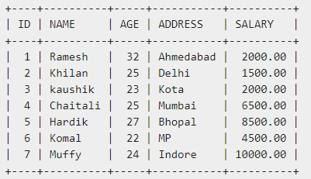
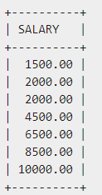
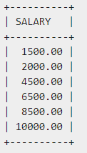
Distinct Keyword
The SQL DISTINCT keyword is used in conjunction with the SELECT statement to eliminate all the duplicate records and fetching only unique records.
Syntax:
SELECT DISTINCT column1, column2,...columnN FROM <table_name> WHERE [condition]
Example:
Consider the CUSTOMERS table having the following records
SQL> SELECT SALARY FROM CUSTOMERS ORDER BY SALARY;
SQL> SELECT DISTINCT SALARY FROM CUSTOMERS ORDER BY SALARY;

Slide 49
Join
Combine records from two or more tables

Slide 50
SQL Joins clause
Joins clause is used to combine records from two or more tables in a database. A JOIN is a means for combining fields from two tables by using common values (foreign key).
Example:
Suppose we have “Orders” and “Customers” tables
Orders
Customers
OrderID | CustomerID | OrderDate
10308 | 2 | 1996-09-18
10309 | 37 | 1996-09-19
10310 | 77 | 1996-09-20
CustomerID | CustomerName | ContactName | Country
1 | Alfreds Futterkiste | Maria Anders | Germany
2 | Ana Trujillo helados | Ana Trujillo | Mexico
3 | Antonio Moreno Taquería | Antonio Moreno | Mexico
Let us join these two tables in our SELECT statement as shown below.
SELECT Orders.OrderID, Customers.CustomerName, Orders.OrderDate FROM Orders, Customers WHERE Orders.CustomerID=Customers.CustomerID;
OrderID | CustomerName | OrderDate
10308 | Ana Trujillo Emparedados y helados | 9/18/1996
10365 | Antonio Moreno Taquería | 11/27/1996
10383 | Around the Horn | 12/16/1996
10355 | Around the Horn | 11/15/1996
10278 | Berglunds snabbköp | 8/12/1996

Slide 51
SELECT Orders.OrderID, Customers.CustomerName, Orders.OrderDate FROM Orders, Customers WHERE Orders.CustomerID=Customers.CustomerID;
SELECT Orders.OrderID, Customers.CustomerName, Orders.OrderDate FROM Orders, Customers WHERE Orders.CustomerID=Customers.CustomerID;
OrderID | CustomerName | OrderDate
10308 | Ana Trujillo Emparedados y helados | 9/18/1996
10365 | Antonio Moreno Taquería | 11/27/1996
10383 | Around the Horn | 12/16/1996
10355 | Around the Horn | 11/15/1996
10278 | Berglunds snabbköp | 8/12/1996
Notice that we use the "CustomerID" column in the "Orders" table and the "CustomerID" in the "Customers" table with equality as our test condition. This is same with what we have been discussed in the operation “inner join”. (recall what is inner join)
SELECT Orders.OrderID, Customers.CustomerName, Orders.OrderDate FROM Orders INNER JOIN Customers ON Orders.CustomerID=Customers.CustomerID;
This SQL statement will produce the same result as the previous select statement. We also know that SQL have different joins:
INNER JOIN − returns rows when there is a match in both tables.
LEFT JOIN − returns all rows from the left table, even if there are no matches in the right table.
RIGHT JOIN − returns all rows from the right table, even if there are no matches in the left table.
FULL JOIN − returns rows when there is a match in one of the tables.
SELF JOIN − is used to join a table to itself as if the table were two tables, temporarily renaming at least one table in the SQL statement.
CARTESIAN JOIN − returns the Cartesian product of the sets of records from the two or more joined tables.

Slide 52
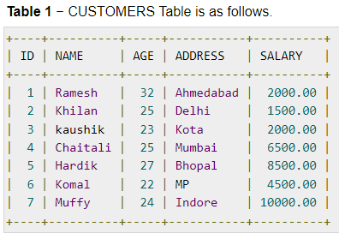
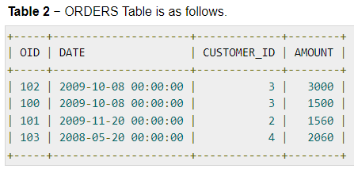
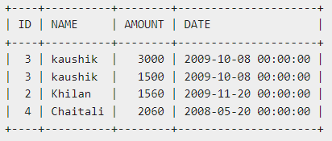
INNER JOINS
INNER JOIN is also referred to as an EQUIJOIN. The INNER JOIN creates a new result table by combining column values of two tables (table1 and table2) based upon the equality (and any other relational operators).
Syntax:
SELECT table1.column1, table2.column2... FROM table1 INNER JOIN table2 ON table1.common_field = table2.common_field;
Example:
Consider the following two tables.
INNER JOIN statement
SQL> SELECT ID, NAME, AMOUNT, DATE FROM CUSTOMERS INNER JOIN ORDERS ON CUSTOMERS.ID = ORDERS.CUSTOMER_ID;

Slide 53
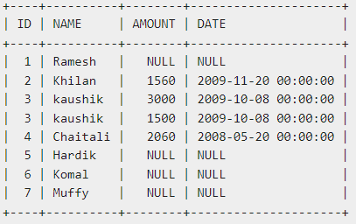
LEFT JOINS
LEFT JOIN returns all rows from the left table, even if there are no matches in the right table. This means that if the ON clause matches 0 (zero) records in the right table; the join will still return a row in the result, but with NULL in each column from the right table.
Syntax:
SELECT table1.column1, table2.column2... FROM table1 LEFT JOIN table2 ON table1.common_field = table2.common_field;
Example:
Consider the following two tables.
LEFT JOIN statement
SQL> SELECT ID, NAME, AMOUNT, DATE FROM CUSTOMERS LEFT JOIN ORDERS ON CUSTOMERS.ID = ORDERS.CUSTOMER_ID;

Slide 54
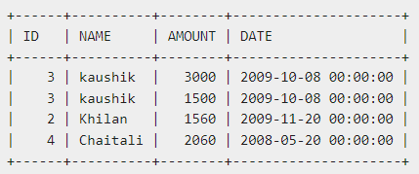
RIGHT JOINS
RIGHT JOIN returns all rows from the right table, even if there are no matches in the left table. This means that if the ON clause matches 0 (zero) records in the left table; the join will still return a row in the result, but with NULL in each column from the left table.
Syntax:
SELECT table1.column1, table2.column2... FROM table1 RIGHT JOIN table2 ON table1.common_field = table2.common_field;
Example:
Consider the following two tables.
RIGHT JOIN statement
SQL> SELECT ID, NAME, AMOUNT, DATE FROM CUSTOMERS RIGHT JOIN ORDERS ON CUSTOMERS.ID = ORDERS.CUSTOMER_ID;

Slide 55
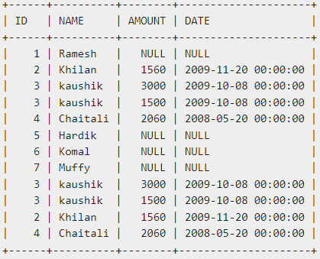
FULL JOINS
FULL JOIN combines the results of both left and right outer joins. The joined table will contain all records from both the tables and fill in NULLs for missing matches on either side. MySQL does not have FULL JOIN.
Syntax:
SELECT table1.column1, table2.column2... FROM table1 FULL JOIN table2 ON table1.common_field = table2.common_field;
Example:
Consider the following two tables.
RIGHT JOIN statement
SQL> SELECT ID, NAME, AMOUNT, DATE FROM CUSTOMERS FULL JOIN ORDERS ON CUSTOMERS.ID = ORDERS.CUSTOMER_ID;

Slide 56
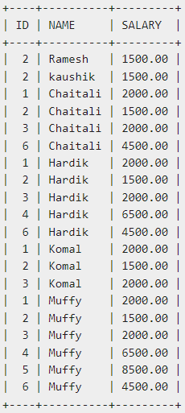
SELF JOINS
SELF JOIN is used to join a table to itself as if the table were two tables; temporarily renaming at least one table is needed in the SQL statement.
Syntax:
SELECT a.column_name, b.column_name...FROM table1 a, table1 b
WHERE a.common_field = b.common_field;
Example:
Consider the following two tables.
SELF JOIN statement
SQL> SELECT a.ID, b.NAME, a.SALARY
FROM CUSTOMERS a, CUSTOMERS b
WHERE a.SALARY < b.SALARY;

Slide 57
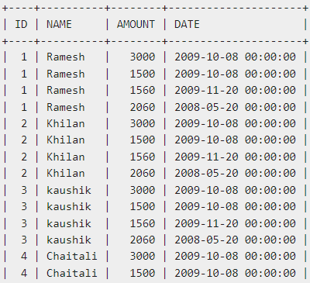
CARTESIAN JOINS
CARTESIAN JOIN returns the Cartesian product of the sets of records from two or more joined tables. Thus, it equates to an inner join where the join-condition always True.
Syntax:
SELECT table1.column1, table2.column2...
FROM table1, table2 [, table3 ];
Example:
Consider the following two tables.
CARTESIAN JOIN statement
SQL> SELECT ID, NAME, AMOUNT, DATE
FROM CUSTOMERS, ORDERS;
…

Slide 58
Combine multiple results
UNION, INTERSECT, and EXCEPT

Slide 59
UNION
UNION operator is used to combine the results of two or more SELECT statements without returning any duplicate rows.
Every SELECT statement within UNION must have the same number of columns
The columns must also have similar data types
The columns in every SELECT statement must also be in the same order
Syntax:
SELECT column_name(s) FROM table1 [WHERE condition]
UNION
SELECT column_name(s) FROM table2[WHERE condition];
The UNION operator selects only distinct values by default. To allow duplicate values, use UNION ALL:
SELECT column_name(s) FROM table1 [WHERE condition]
UNION ALL
SELECT column_name(s) FROM table2[WHERE condition];

Slide 60
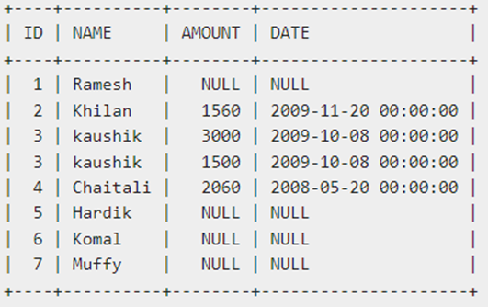
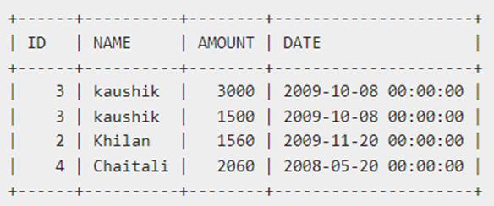
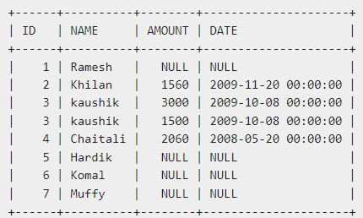
UNION Examples
Consider the following two tables.
SQL> SELECT ID, NAME, AMOUNT, DATE FROM CUSTOMERS LEFT JOIN ORDERS ON CUSTOMERS.ID = ORDERS.CUSTOMER_ID
UNION
SELECT ID, NAME, AMOUNT, DATE FROM CUSTOMERS RIGHT JOIN ORDERS ON CUSTOMERS.ID = ORDERS.CUSTOMER_ID;
Will produce the right-hand side results

Slide 61
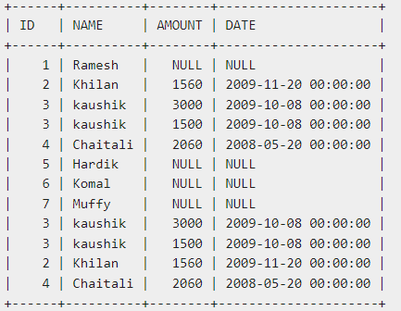
UNION Examples
Consider the following two tables.
SQL> SELECT ID, NAME, AMOUNT, DATE FROM CUSTOMERS LEFT JOIN ORDERS ON CUSTOMERS.ID = ORDERS.CUSTOMER_ID
UNION ALL
SELECT ID, NAME, AMOUNT, DATE FROM CUSTOMERS RIGHT JOIN ORDERS ON CUSTOMERS.ID = ORDERS.CUSTOMER_ID;
Will produce the right-hand side results

Slide 62
INTERSECT
INTERSECT operator is used to combine two SELECT statements, but returns rows only from the first SELECT statement that are identical to a row in the second SELECT statement. This means INTERSECT returns only common rows returned by the two SELECT statements.
MySQL does not support INTERSECT operator.
Syntax:
SELECT column_name(s) FROM table1 [WHERE condition]
INTERSECT
SELECT column_name(s) FROM table2[WHERE condition];
Example:
The same two tables. We can use EXCEPT to combine two SELECT.
SQL> SELECT ID, NAME, AMOUNT, DATE FROM CUSTOMERS LEFT JOIN ORDERS ON CUSTOMERS.ID = ORDERS.CUSTOMER_ID
INTERSECT
SELECT ID, NAME, AMOUNT, DATE FROM CUSTOMERS RIGHT JOIN ORDERS ON CUSTOMERS.ID = ORDERS.CUSTOMER_ID;

Slide 63
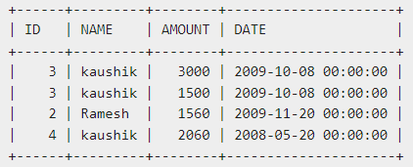
SQL> SELECT ID, NAME, AMOUNT, DATE FROM CUSTOMERS LEFT JOIN ORDERS ON CUSTOMERS.ID = ORDERS.CUSTOMER_ID
INTERSECT
SELECT ID, NAME, AMOUNT, DATE FROM CUSTOMERS RIGHT JOIN ORDERS ON CUSTOMERS.ID = ORDERS.CUSTOMER_ID;
The common rows returned by the two SELECT statements.

Slide 64
EXCEPT
EXCEPT operator is used to combine two SELECT statements and returns rows from the first SELECT statement that are not returned by the second SELECT statement. This means EXCEPT returns only rows, which are not available in the second SELECT statement.
MySQL does not support Except.
Syntax:
SELECT column_name(s) FROM table1 [WHERE condition]
EXCEPT
SELECT column_name(s) FROM table2[WHERE condition];
Example:
The same two tables. We can use EXCEPT to combine two SELECT.
SQL> SELECT ID, NAME, AMOUNT, DATE FROM CUSTOMERS LEFT JOIN ORDERS ON CUSTOMERS.ID = ORDERS.CUSTOMER_ID
EXCEPT
SELECT ID, NAME, AMOUNT, DATE FROM CUSTOMERS RIGHT JOIN ORDERS ON CUSTOMERS.ID = ORDERS.CUSTOMER_ID;

Slide 65
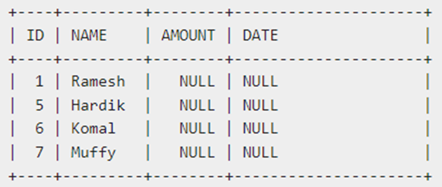
SQL> SELECT ID, NAME, AMOUNT, DATE FROM CUSTOMERS LEFT JOIN ORDERS ON CUSTOMERS.ID = ORDERS.CUSTOMER_ID
EXCEPT
SELECT ID, NAME, AMOUNT, DATE FROM CUSTOMERS RIGHT JOIN ORDERS ON CUSTOMERS.ID = ORDERS.CUSTOMER_ID;
The rows in the first return but not in the second select return is

Slide 66
Other Operations
Index, view and transactions

Slide 67
Indexes
Indexes are special lookup tables that the database search engine can use to speed up data retrieval.
Creating an index needs the CREATE INDEX statement, which allows you to name the index, to specify the table and which column or columns to index, and to indicate whether the index is in an ascending or descending order.
Indexes can also be unique, like the UNIQUE constraint, in that the index prevents duplicate entries in the column or combination of columns on which there is an index.
Syntax:
CREATE INDEX index_name ON table_name;
Single-Column Indexes
CREATE INDEX index_name ON table_name (column_name);
Unique Indexes
CREATE UNIQUE INDEX index_name on table_name (column_name);
Composite Indexes
CREATE INDEX index_name on table_name (column1, column2);
DROP INDEX
DROP INDEX index_name;

Slide 68
Views
A view is actually a composition of a table in the form of a predefined SQL query.
A view can contain all rows of a table or select rows from a table.
A view can be created from one or many tables.
Database views are created using the CREATE VIEW statement.
A view can be updated under conditions that SELECT uses to create view has to be the normal SELECT(no extra constraints), update a view is actually update the original tables.
We can inserting or deleting rows in a view under the same conditions as update view.
A view can be dropped if it is no longer needed using
CREATE VIEW <view_name> AS SELECT column1, column2..... FROM table_name WHERE [condition];
SQL > UPDATE CUSTOMERS_VIEW SET AGE = 35 WHERE name = 'Ramesh';
DROP VIEW <view_name>;

Slide 69
SQL Stored Procedures
A stored procedure is a prepared SQL code that you can save, so the code can be reused over and over again.
So if you have an SQL query that you write over and over again, save it as a stored procedure, and then just call it to execute it.
You can also pass parameters to a stored procedure, so that the stored procedure can act based on the parameter value(s) that is passed.
Stored Procedure Syntax
Execute a Stored Procedure
CREATE PROCEDURE <procedure_name> AS <sql_statement> GO;
EXEC procedure_name;

Slide 70
Transactions
A transaction is a unit of work that is performed against a database. This unit of work can be creating a record or updating a record or deleting a record from the table.
transaction on that table can be controlled to ensure the data integrity and to handle database errors.
The following commands are used to control transactions.
COMMIT − to save the changes.
ROLLBACK − to roll back the changes.
SAVEPOINT − creates points within the groups of transactions in which to ROLLBACK to.
SET TRANSACTION − Places a name on a transaction and set access control as “READ WRITE” or “READ ONLY”.
Every transaction must have an explicit end statement, which is either a COMMIT or a ROLLBACK.

Slide 71
Import and export data

Slide 72
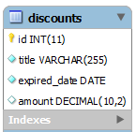
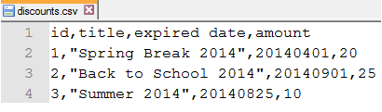
Import CSV File
The LOAD DATA INFILE statement allows you to read data from a text file and import the file’s data into a database table very fast.
Before importing the file, you need to prepare the following:
A database table to which the data from the file will be imported.
A CSV file with data that matches with the number of columns of the table and the type of data in each column.
Example:
Suppose we have a table named discounts with the following structure:
CREATE TABLE discounts (
id INT NOT NULL AUTO_INCREMENT,
title VARCHAR(255) NOT NULL,
expired_date DATE NOT NULL,
amount DECIMAL(10 , 2 ) NULL,
PRIMARY KEY (id)
);
LOAD DATA INFILE 'c:/tmp/discounts.csv’
INTO TABLE discounts
FIELDS TERMINATED BY ',’
ENCLOSED BY '“’
LINES TERMINATED BY '\n’
IGNORE 1 ROWS;

Slide 73
Export table to CSV File
SQL provides an easy way to export the query’s result into a CSV file that resides in the database server.
Before exporting data, you must ensure that:
The MySQL server’s process has the write access to the target folder that contains the target CSV file.
The target CSV file must not exist.
Example:
Suppose we have a table named order and a SELECT statement. WE want the result to be exported to a CVS file.
SELECT
orderNumber, status, orderDate, requiredDate, comments
FROM
orders
WHERE
status = 'Cancelled';
SELECT
orderNumber, status, orderDate, requiredDate, comments
FROM
orders
WHERE
status = 'Cancelled'
INTO OUTFILE 'C:/tmp/cancelled_orders.csv'
FIELDS ENCLOSED BY '"'
TERMINATED BY ';'
ESCAPED BY '"'
LINES TERMINATED BY '\r\n';

Slide 74
https://www.tutorialspoint.com/sql/ Mock test
Video:
https://www.youtube.com/watch?v=7S_tz1z_5bA
Self exercise and testing

